Slide 1
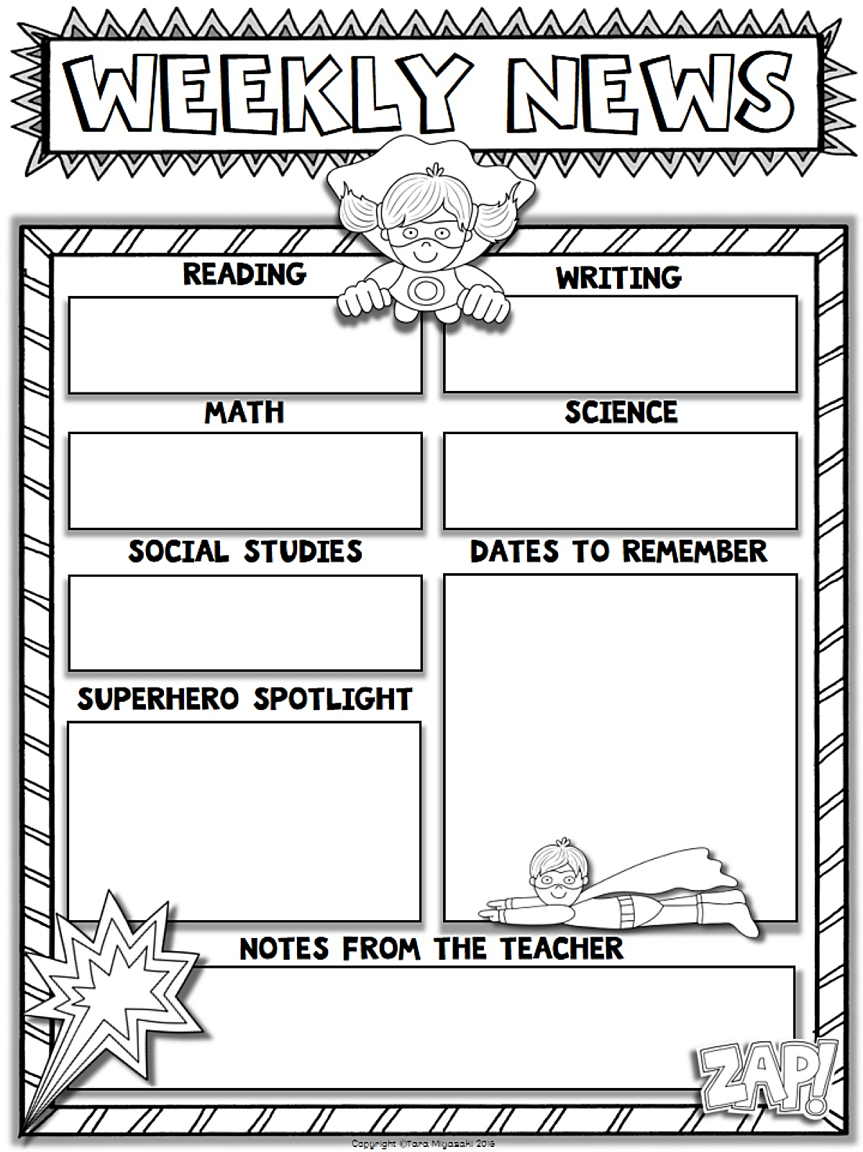
Mrs. Tonya Newton
November 13, 2017
Thanksgiving is our topic this week. We will be reading fiction and non-fiction stories about this holiday.
We will be writing about what we are thankful for. We will also be writing about our disguised turkeys. They are all so cute!!
We will continue learning about greater than, less than, equal to, and counting to 100 by 10s and 1s.
.
Students will conduct a group research project on their choice of Pilgrims, Indians, turkeys, or the Mayflower.
Nov 16: Family Night Obstacle Course – 5:15-6:15 Pizza and drinks will be sold.
5:30-6:30 Obstacle Course, STEAM activities in classrooms
Nov 16: Fundraiser items delivered & can be picked up after 4:00
Nov 17: Student of the Month breakfast and Perfect Attendance WII Party
Nov 20-24: Thanksgiving holidays for all
Nov 27: Everyone returns to school
Nov 30: PBIS After School Party
The disguised turkey projects were a huge success!! We had almost 100% participation. Thanks for taking the time and helping your child with this project. We will have another family project in December.
Please go online and complete the survey about our school. It’s only 24 questions and shouldn’t take very long. Thank you!
http://gshs.gadoe.org/parents.
***The next Reading Party is December 13 and students must
know 25 sight words to attend! Study, study, study!!

Slide 2
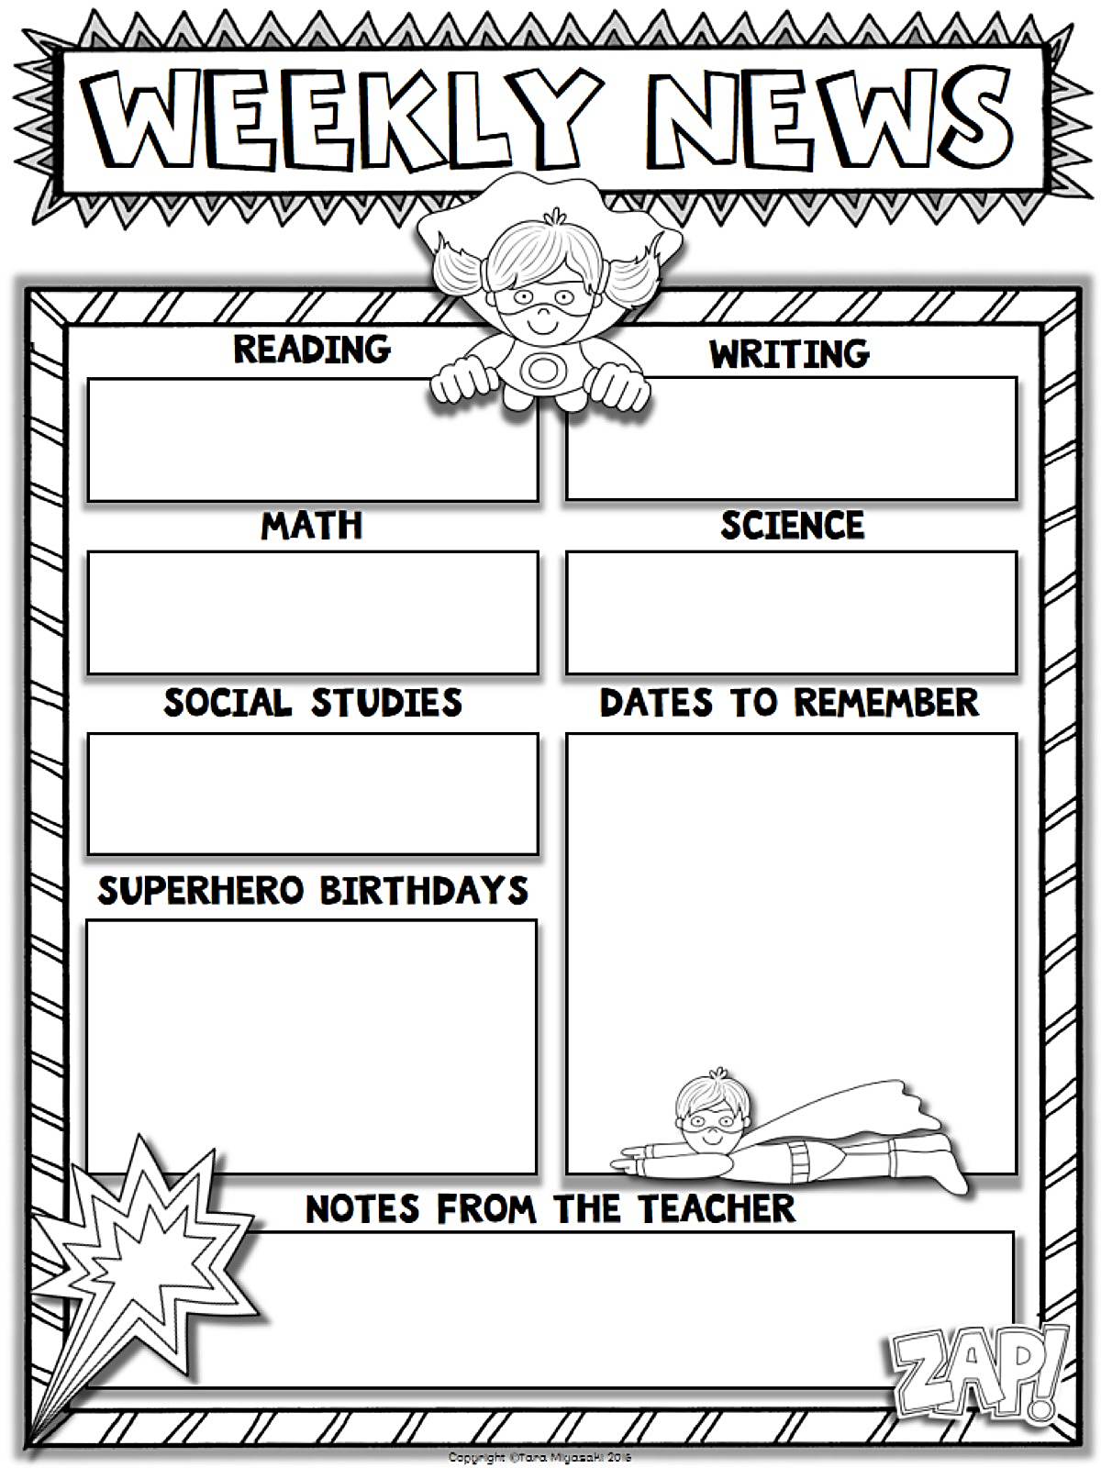
Type Teacher’s Name
Type Date Here
Start Typing Here
Start Typing Here
Start Typing Here
Start Typing Here
Start Typing Here
Start Typing Here
Start Typing Here
Start Typing Here

Slide 3
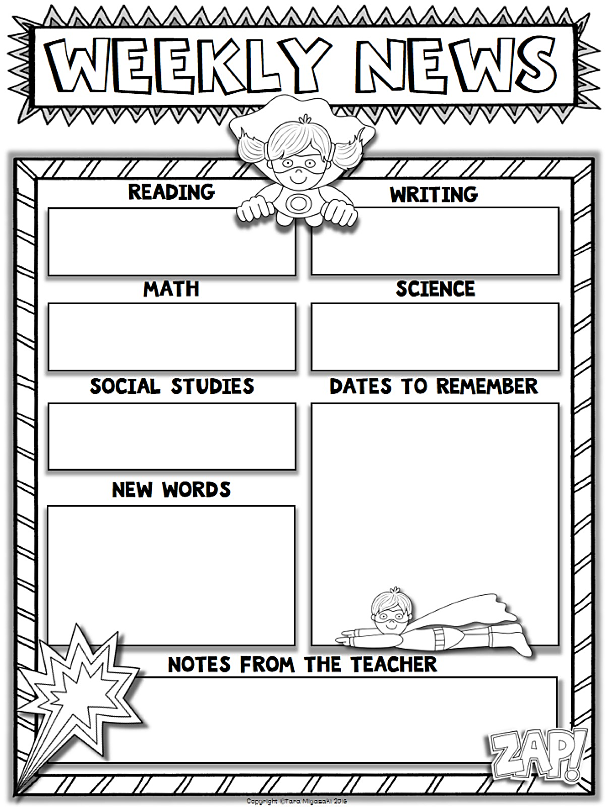
Type Teacher’s Name
Type Date Here
Start Typing Here
Start Typing Here
Start Typing Here
Start Typing Here
Start Typing Here
Start Typing Here
Start Typing Here
Start Typing Here

